Slide 1





Influences of turbulence and combustion regimes on explosions of gas-dust hydrid mixtures
Nicolas CUERVO
Rapporteurs:
Pr. Almerinda Di BENEDETTO
Dr. Ing. Michel MOLIÈRE
Examinateurs:
Pr. Philippe GILLARD
Dr. Ing. Alexis VIGNES
Pr. Olivier DUFAUD
Pr. Laurent PERRIN
Ecole Doctorale Ressources Procédés Produits Environnement
Notes:
Merci Monsieur le president

Slide 2
General outline
Introduction
Pyrolysis model
Quantification of turbulence
Flame propagation
Conclusions
Notes:
3 subjects that may seem to not being related to each other

Slide 3

Introduction
Introduction
Pyrolysis model
Quantification of turbulence
Flame propagation
Conclusions

Slide 4
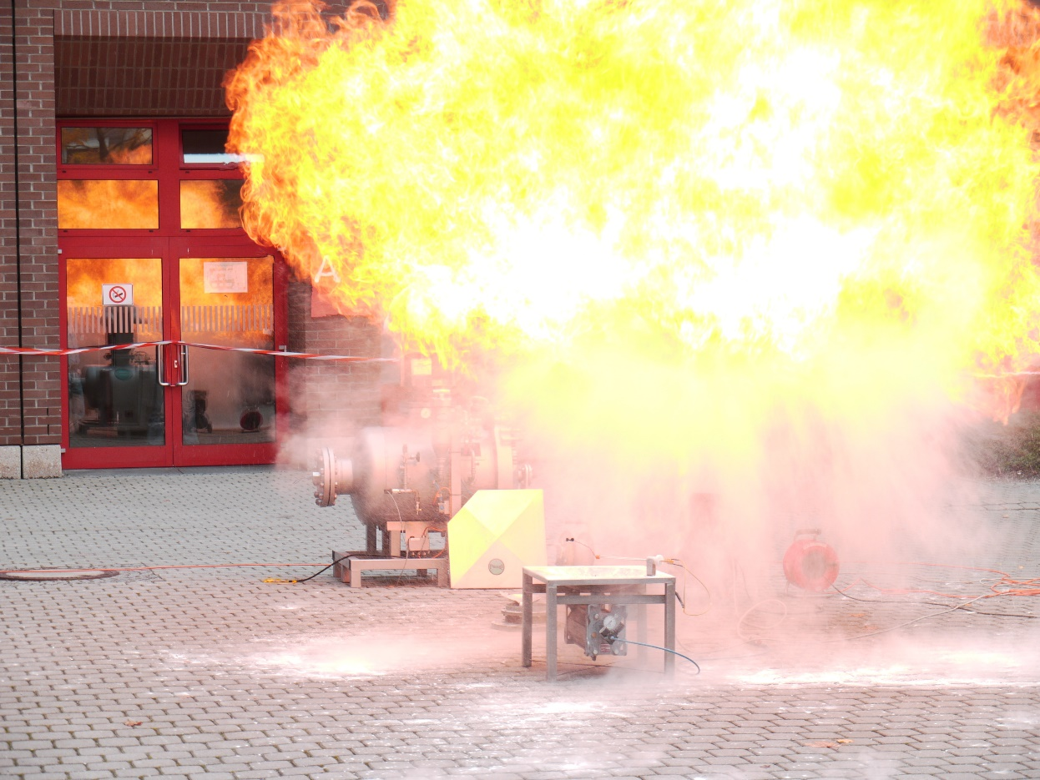
How do dust explosions happen?
Introduction
Combustible dusts: starch, sawdust, magnesium, aluminium...
High surface area
Dispersed in a cloud + ignition source → particles can be easily reached by oxygen
Simultaneous combustion of the particles in the cloud → liberation of hot burnt gases → explosion
Notes:
3. When dispersed in a dust cloud
with a high enough concentration
need only of a source of ignition

Slide 5

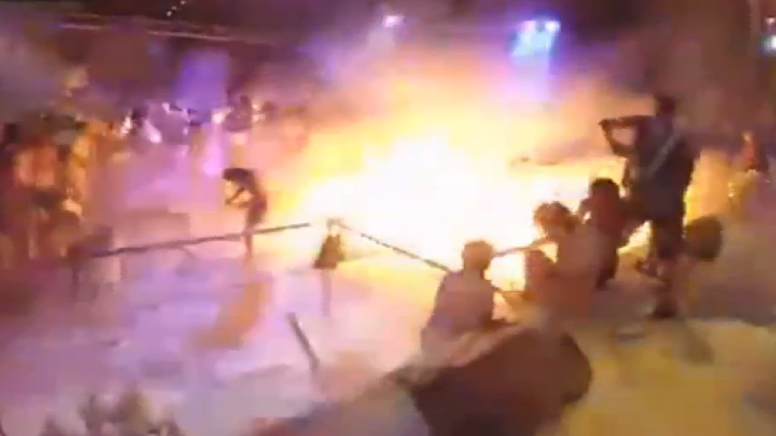
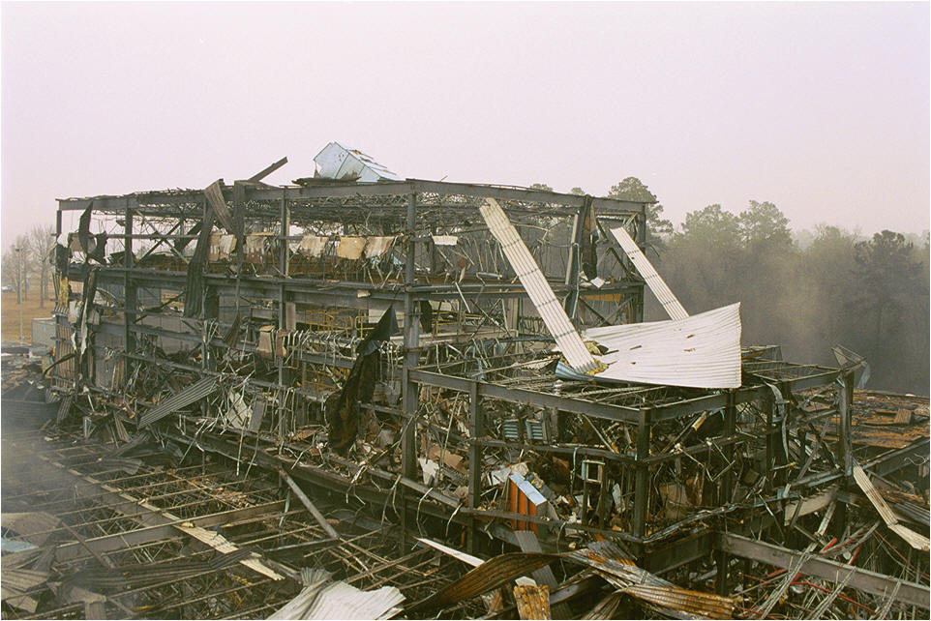
Is this really a concern?
Introduction
FORMER
FORMER
FORMER
Wednesday August 20th 1997
Friday, june 26th 2015
Wednesday, january 29th 2003
Wheat silo explosion leaves 11 people dead and 1 person seriously injured in Blaye, France
The dramatic explosion of a grain storage silo, which occurred Wednesday in Blaye (Gironde) and that made 11 dead and 1 seriouly injured, lies the issue of safety standards in this type of installation. In 1983, a year after the explosion in the maltery at Metz that had killed 12 people, the Ministry of the Environment issued an order to reinforce the 1976 legislation on installations subject to declaration. Today, after the drama of Blaye, "it would be absurd that rise the standards" said an industry professional. For now however, the Agriculture Minister, Louis Le Pensec, only yesterday stressed "the need to implement all the information and prevention measures necessary."
At least 510 people were injured -- 183 of them hospitalized in intensive care units -- after flammable powder apparently exploded in midair at a recreational water park in Taiwan, the East Asian island's official Central News Agency reported.
Eight of the injured were reported to be in critical condition Sunday morning. Forty-three people had been discharged from hospitals after treatment.
The flames erupted when the unknown substance blew up over a stage around 8:30 p.m. Saturday (8:30 a.m. ET) at Formosa Fun Coast, firefighters said, according to the CNA report.
12 people dead and 495 injured leaves a explosion of coloured corn-starch at water park party in Taiwan
An explosion and fire erupted at the West Pharmaceutical Services plant in Kinston Wednesday afternoon, killing at least three people, injuring at least 37 and leaving the building a shattered ruin marked by flames and a column of black smoke.
Thursday morning, West Pharmaceuticals identified two of the three victims of the explosion and fire at the Kinston plant.
The victims were identified as William Gray and Faye Wilkins. The third person was identified as a contract worker employed by a cleaning service. His name has not been confirmed..
6 people dead and 36 injured is the aftermath of the explosion of powdered polyethylene at West pharmaceutical in Kinston, USA
YES!

Slide 6
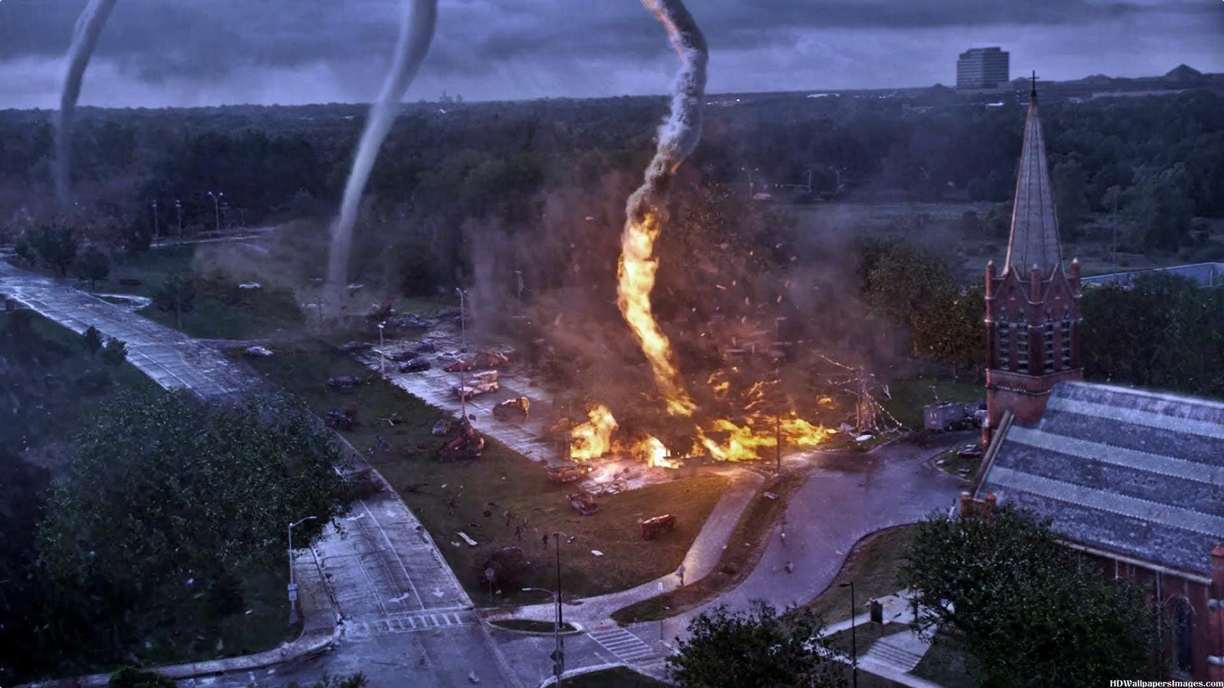
It can be worse
Introduction
Coal mines: carbon and methane
Pharmaceutical industry: excipients and solvents
Pigment industry: dusts and solvents
Agroindustry: cereal and fermentation products

Slide 7
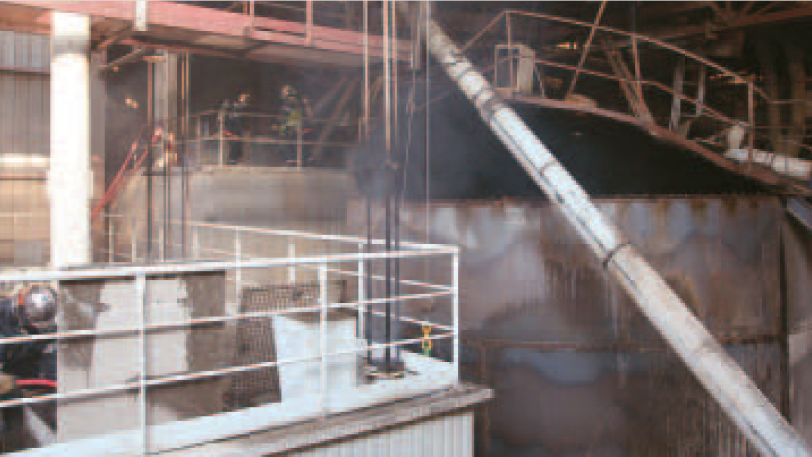
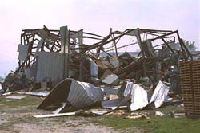
It has been worse
Introduction
FORMER
FORMER
Friday, march 29th 2006
Friday, may 8th
1997
Murphy’s law:
“If something bad can happen, it will certainly happen”
Silo containing canola oilcakes exploses at Aigueperse and injures 5 workers, 2 seriously.
Sanders, well known
in the sector, produces
animal feed from raw materials varied gin
gine plant: rapeseed, sunflower, grape pulp, corn ... These plant materials are stored powder form in metal frame of silos twenty meters high, especially
mounted with a metal cladding.
For some reason, one of these silos undergoes early afternoon a violent deflagration. Five workers worked in top
were wounded, two seriously. The first detachment finds the five workers were able to go down the stairs and they are grouped at the foot of building. Suffer from several serious injuries. The top of silo is gutted but the wave of over-
Pesticide pyrolyzed and exploded killing 3 firefighters and injuring 16 more in Arkansas seriously
On May 8, 1997, a fire at a chemical packaging plant sparked an explosion that killed three West Helena (Ark.) firefighters—Stewart Warren, Ed Hudson and Reginald Robinson. Another 16 firefighters were injured in the blast, which occurred at Bartlo Packaging Inc. (BPS Inc.), a bulk storage and distribution facility that packages agricultural pesticides and herbicides.
According to reports, a chemical was being offloaded into a warehouse when employees noticed smoke coming from the building. City emergency response personnel were notified. A team of four West Helena
Notes:
Canola oilcake + hexane

Slide 8
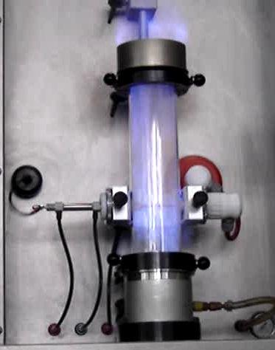
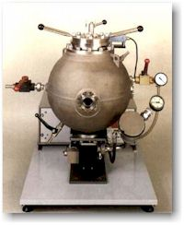
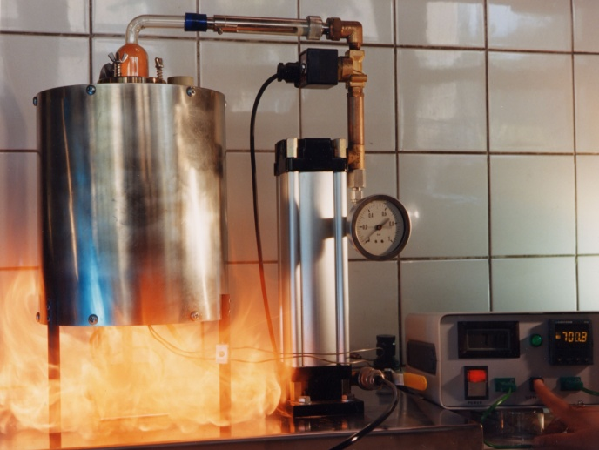
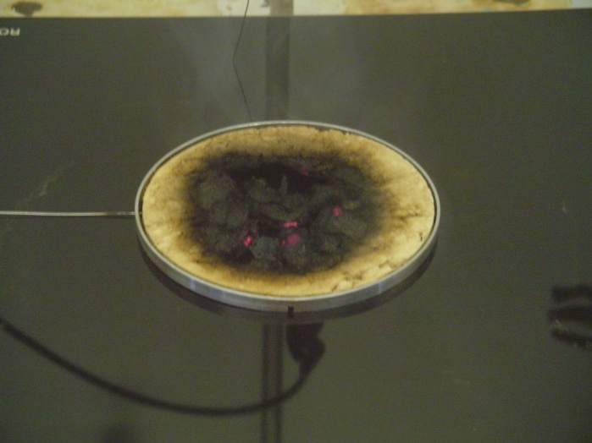
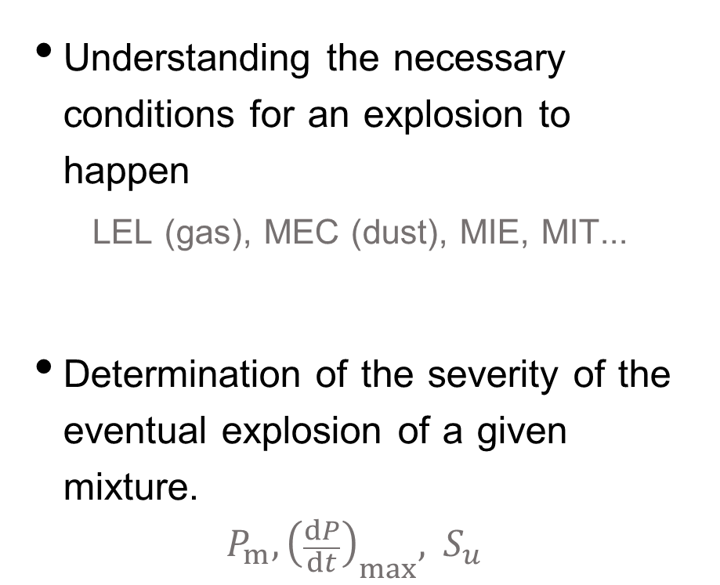
Risk assessment requires
Introduction
Understanding the necessary conditions for an explosion to happen
LEL (gas), MEC (dust), MIE, MIT...
Determination of the severity of the eventual explosion of a given mixture.
$$P_{m}, {\left(\frac{dP}{dt}\right)}_{max}, { S}_{u}$$

Slide 9
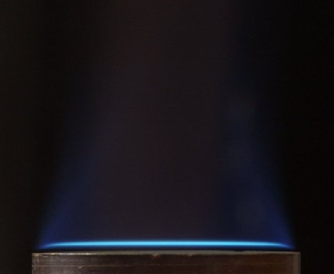
Subjects of study:
Flame propagation
Introduction
Flat gas flames provide the laminar burning velocity
Even stretched turbulent flames could be used to estimate the laminar burning velocity
Flame propagation

Slide 10
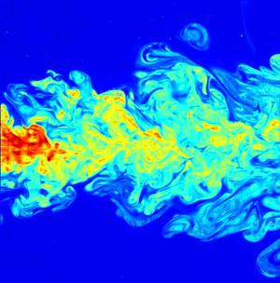
Subjects of study:
Turbulence
Introduction
Initial turbulence:
Necessary for a dust explosion to happen
Mixing the unburnt reactants
Stretching the flame
Increase the flame surface
Breaking the flame
Flame propagation
Turbulence

Slide 11
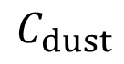
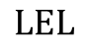
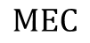
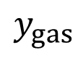
Subjects of study:
regimes of hybrid mixtures
Composition
Introduction
Gas driven
explosion
Dual fuel
explosion
Flame propagation
Turbulence
Composition
$$y_{gas}$$
$$\text{LEL}$$
Synergic
Dust driven
explosion
$$C_{dust}$$
$$\text{MEC}$$

Slide 12
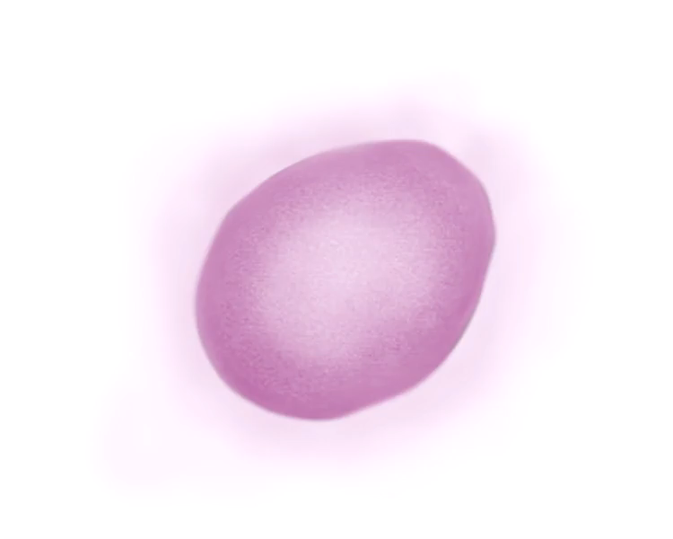
Subjects of study:
Pyrolysis
Introduction
Flame propagation
Turbulence
Composition
Pyrolysis

Slide 13

Subjects of study:
Introduction
Flame propagation
Turbulence
Composition
Pyrolysis

Slide 14
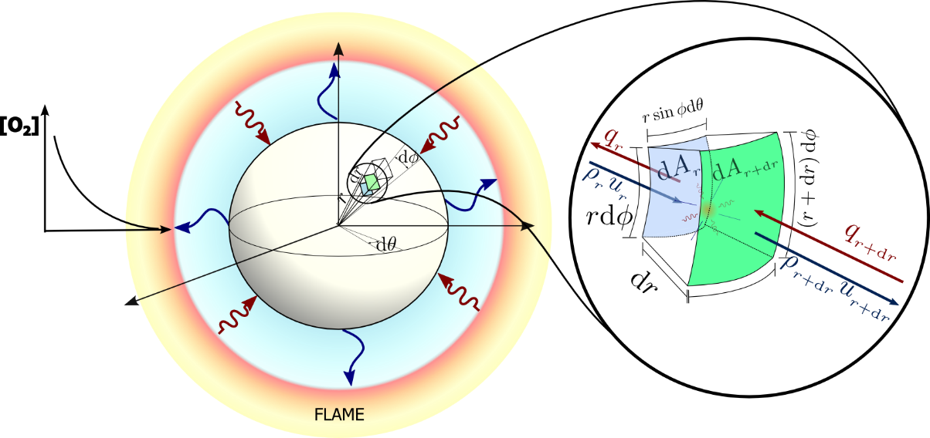
Pyrolysis model
Introduction
Pyrolysis model
Quantification of turbulence
Flame propagation
Conclusions

Slide 15
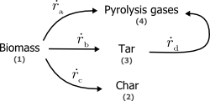
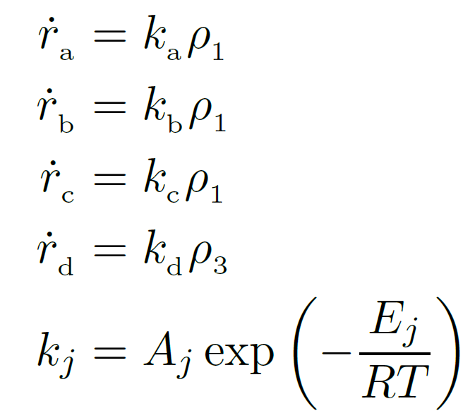
Kinetic model
Pyrolysis
model
Kinetic parameters
Di Blasi and Branca (2001)
Wagenaar et al. (1993)
Font et al. (1990)
Chan et al. (1985)

Slide 16
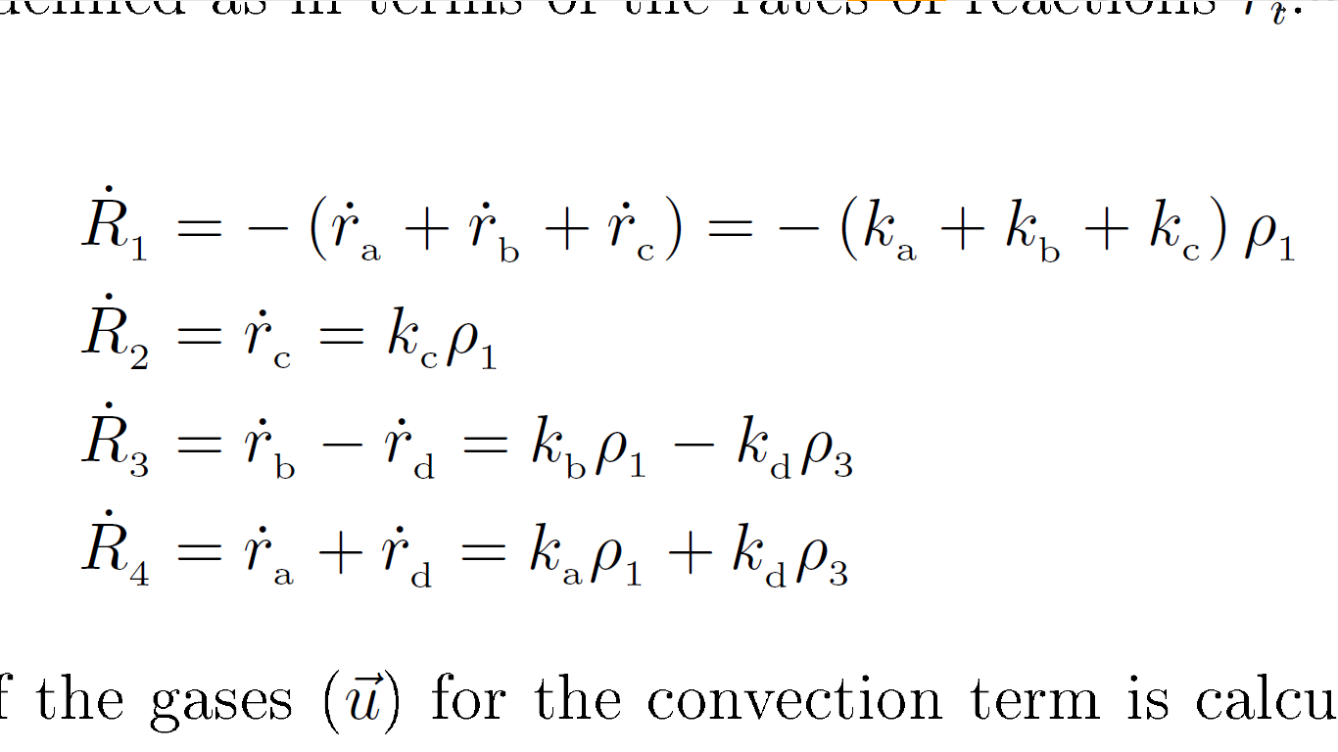
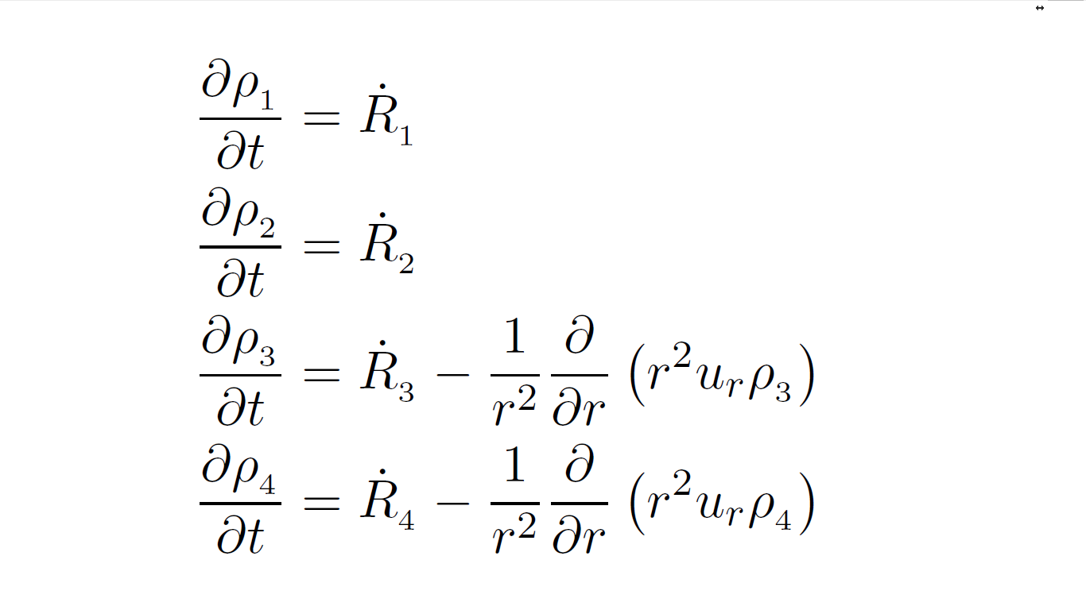
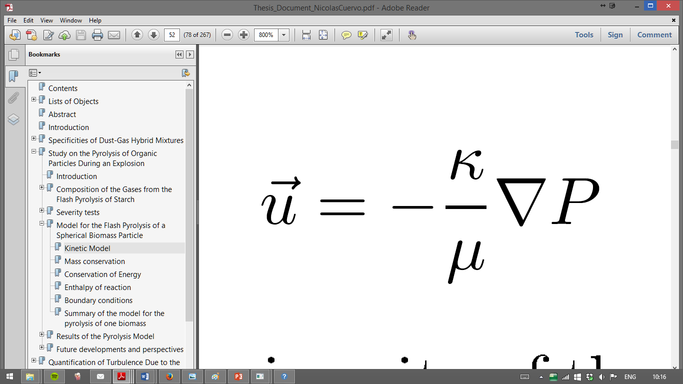
Conservation of Matter
Pyrolysis Model
Biomass:
Char:
Tar:
Gas:
Biomass:
Char:
Tar:
Gas:
Generation terms
Convective terms
Darcy’s Equation:

Slide 17
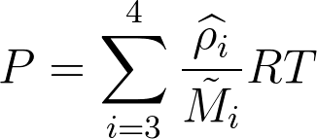
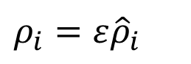
Prioritising pressure
Pyrolysis Model
Biomass:
Char:
Tar:
Gas:
$$ρ_{i}={ε\hat{ρ}}_{i}$$
Gas flow
Temperature variation
Porosity variation – solid volatilization

Slide 18
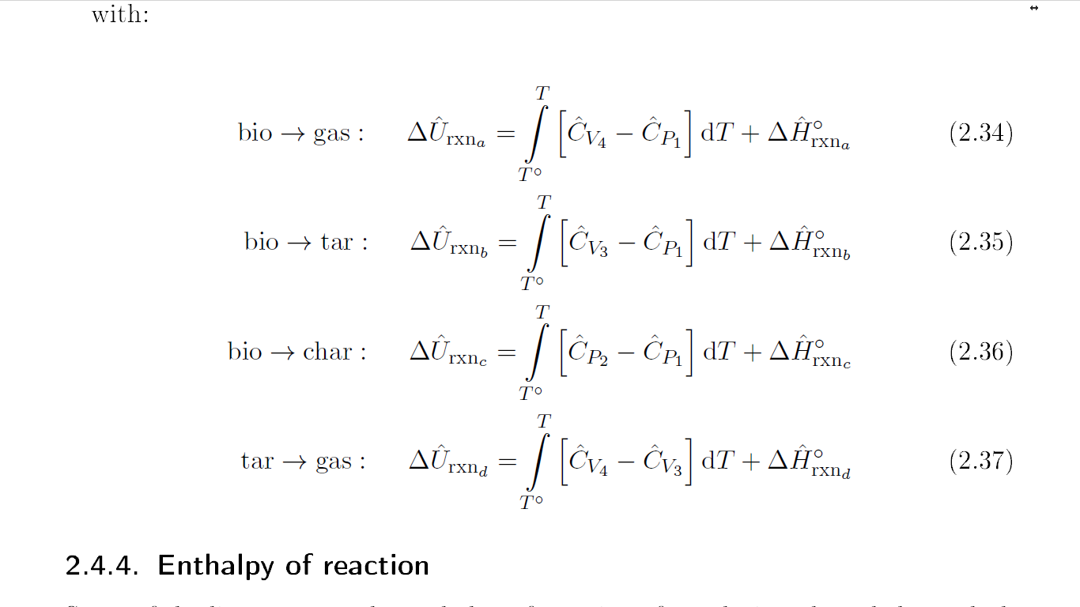
Conservation of energy
Pyrolysis model
Thermal energy entering/leaving by convection
Conductive heat transfer
Compressive/ expansive effect of convection
Reactive heat generation
Exothermic reaction above 750K

Slide 19


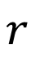
Boundary conditions
Pyrolysis model
Internal boundary, $r=0$
$$0$$
$$r$$

Slide 20
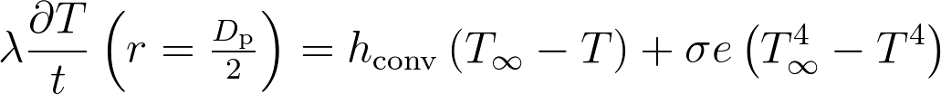
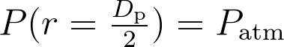
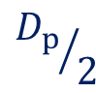
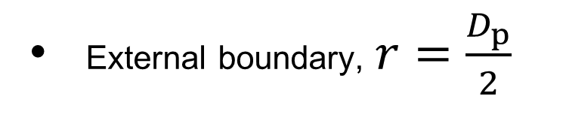
Boundary conditions
Pyrolysis model
External boundary, $r=\frac{D_{p}}{2}$
Conduction
Convection
Radiation
$${D_{p}}/2$$
$$r$$

Slide 21
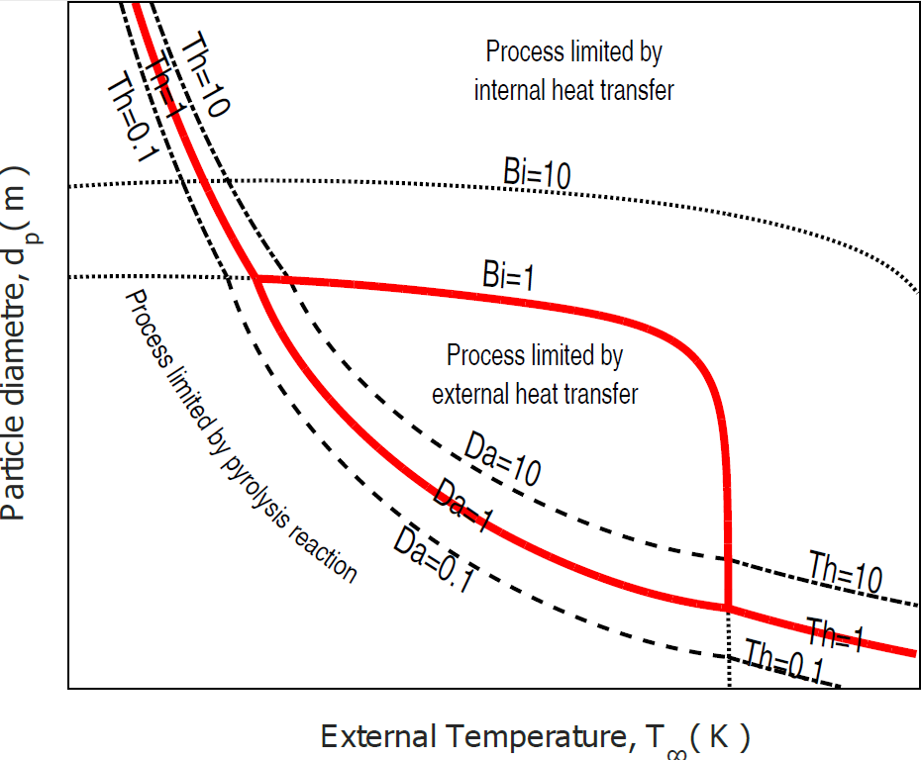
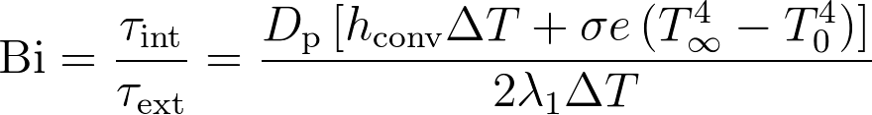
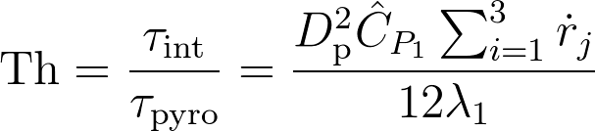
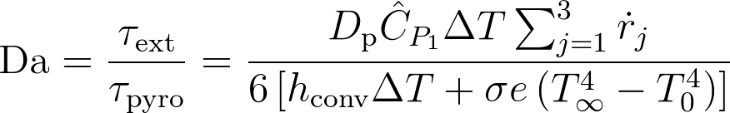
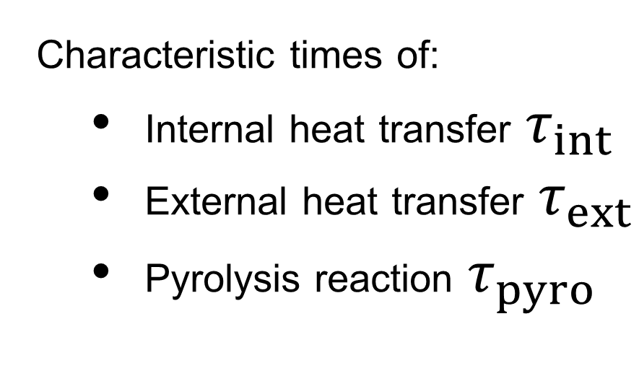
Thermal regimes
Pyrolysis
model
Characteristic times of:
Internal heat transfer $τ_{int}$
External heat transfer $τ_{ext}$
Pyrolysis reaction $τ_{pyro}$

Slide 22
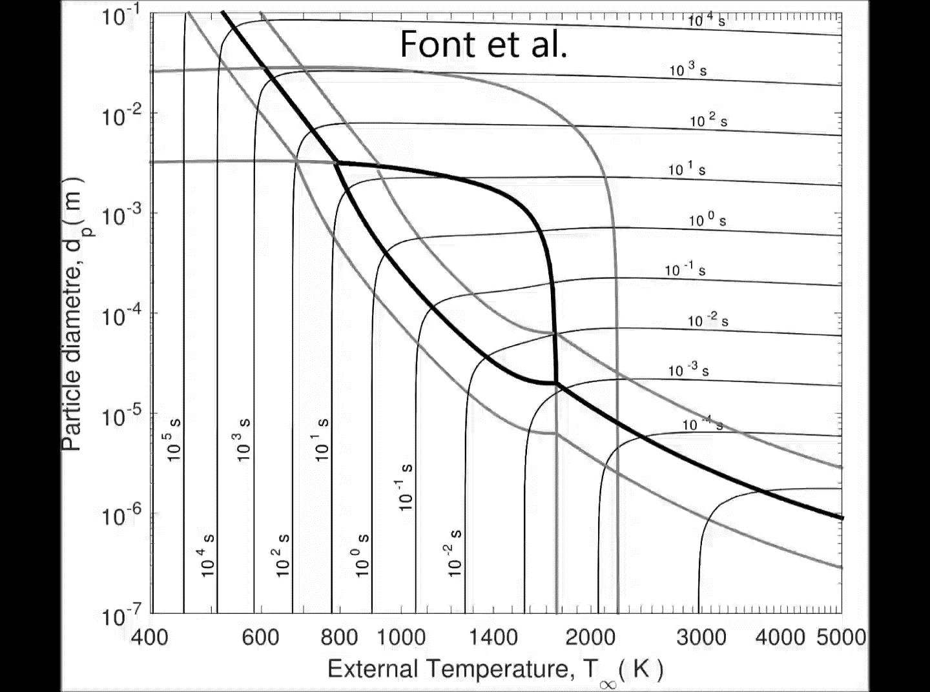
Simulation domain
Pyrolysis
model
Diameter:
5µm-100µm
Temperature:
750K-1200K

Slide 23


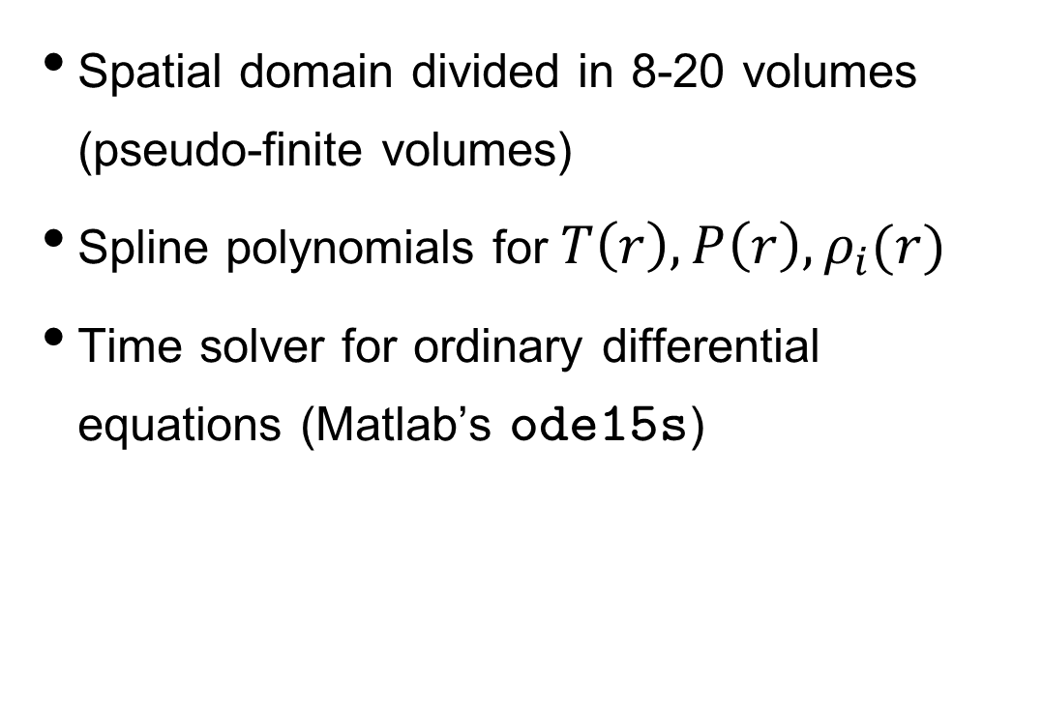
Solution of the model
Pyrolysis model
Spatial domain divided in 8-20 volumes (pseudo-finite volumes)
Spline polynomials for$T\left(r\right), P\left(r\right),ρ_{i}(r)$
Time solver for ordinary differential equations (Matlab’s ode15s)
$$\iint{ \text{d}r\text{d}t}$$

Slide 24
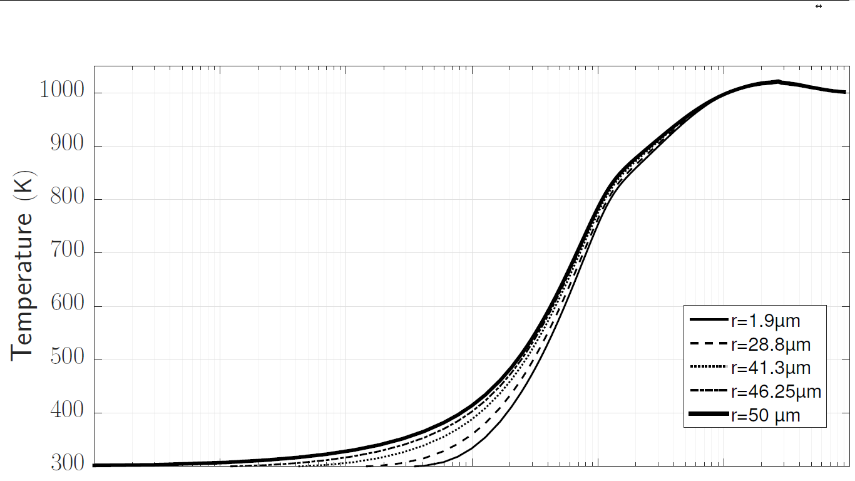
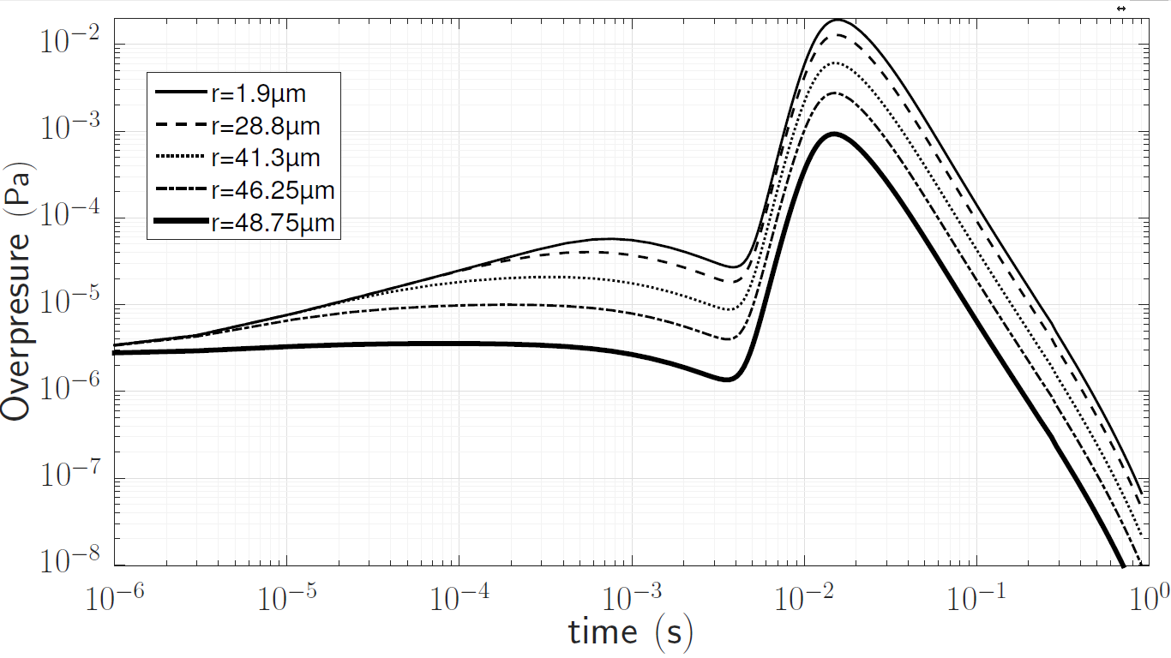
Results: Behaviour of temperature
Pyrolysis
model
Temperature: 1000K
Diameter: 100µm
Kinetics: Font et al.
Notes:
Exothermic kinetics cause higher temperature at thecenter of thepaticle
Slighly more fragile on the inside…
If pyrolysis ispredominant over combustion,shrinking core model would not be useful

Slide 25
Results: Behaviour of the overpressure
Pyrolysis
model
Temperature: 1000K
Diameter: 100µm
Kinetics: Font et al.
Notes:
The over pressure is not quite high - pascals
We tought that pressure would rise and break theparticle from the inside
Consider the implications in a pressurize system
Would the gas flow out?
How does that change the exchange of oxygen?
Would the particle collapse because of the external pressure?

Slide 26
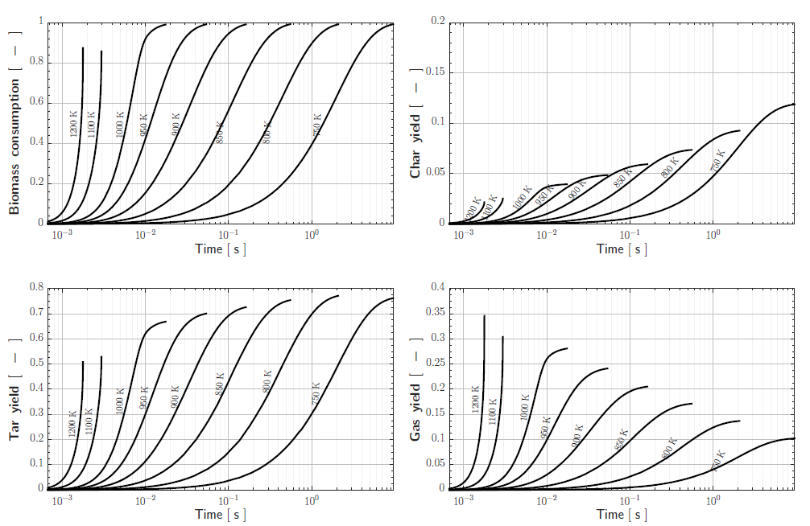
Results
Pyrolysis
model
Diameter: 20µm
Kinetics: Wagenaar et al.
Notes:
Biomass consumption interrumpts for higher temperatures
Char production diminishes as temperature increases
Tar production is predominant but it has a subtle reduction as temperature increases
Gas increases with temperature – the higher the temperature, the more dangereous he mixture will be

Slide 27
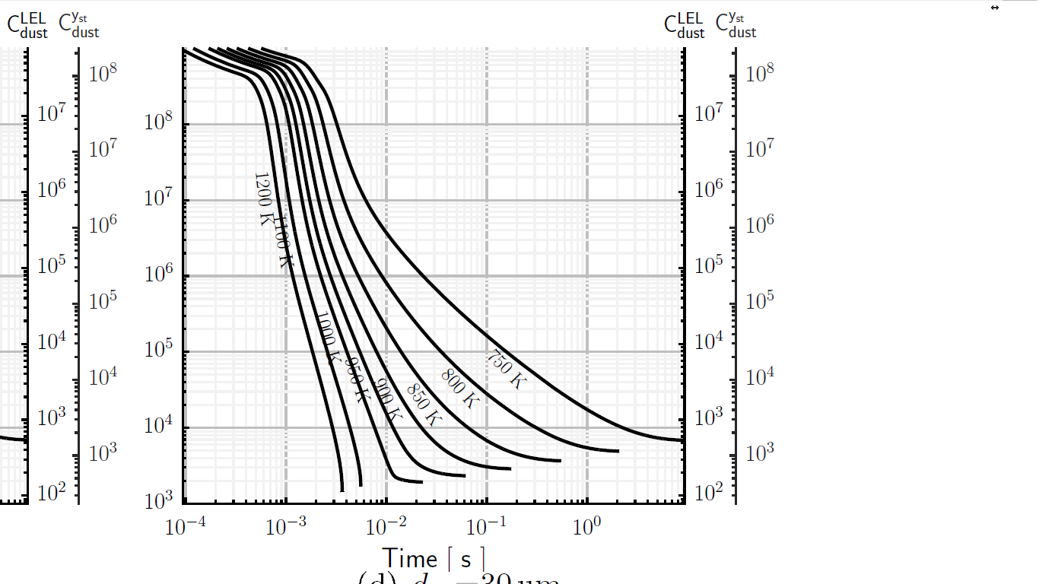
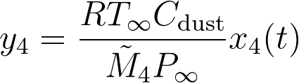
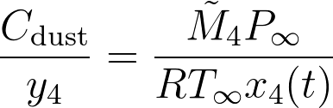
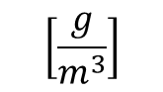
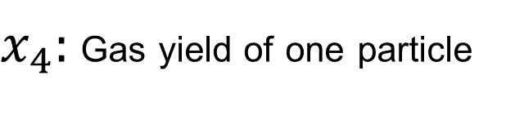
Linking gas production to LEL
Pyrolysis
model
$x_{4}:$ Gas yield of one particle
µGC
Gas concentration in a pyrolyzing dust cloud:
Particle diameter:
30µm
$$\left[\frac{g}{m^{3}}\right]$$
Link between MEC, LEL and ignition?
Notes:
Application: Link between MEC and LEL of pyrolysis gases, the geometry, temperature and lapse of the ignition

Slide 28
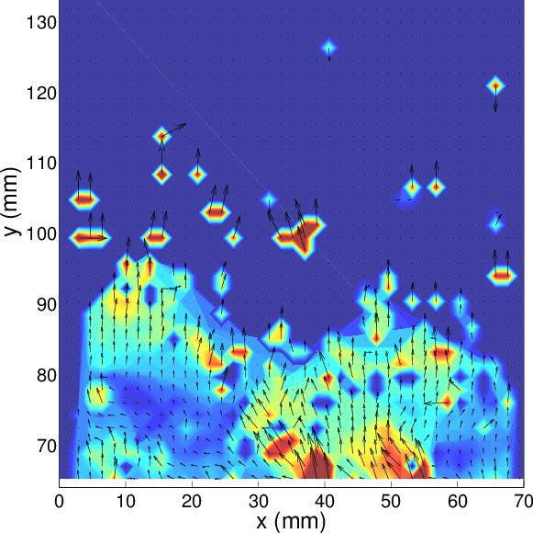
Quantification of turbulence
Introduction
Pyrolysis model
Quantification of turbulence
Flame propagation
Conclusions

Slide 29
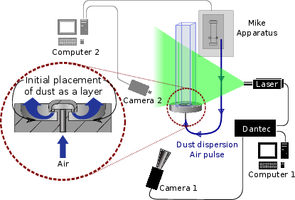
Experimental setup for PIV analysis
Quantification of turbulence
Notes:
Central vertical tube were particles are placed at the bottom
Dispersed by the mike aparatus
laser pulses illuminate the dust cloud and a camera takes pictures allowing to

Slide 30
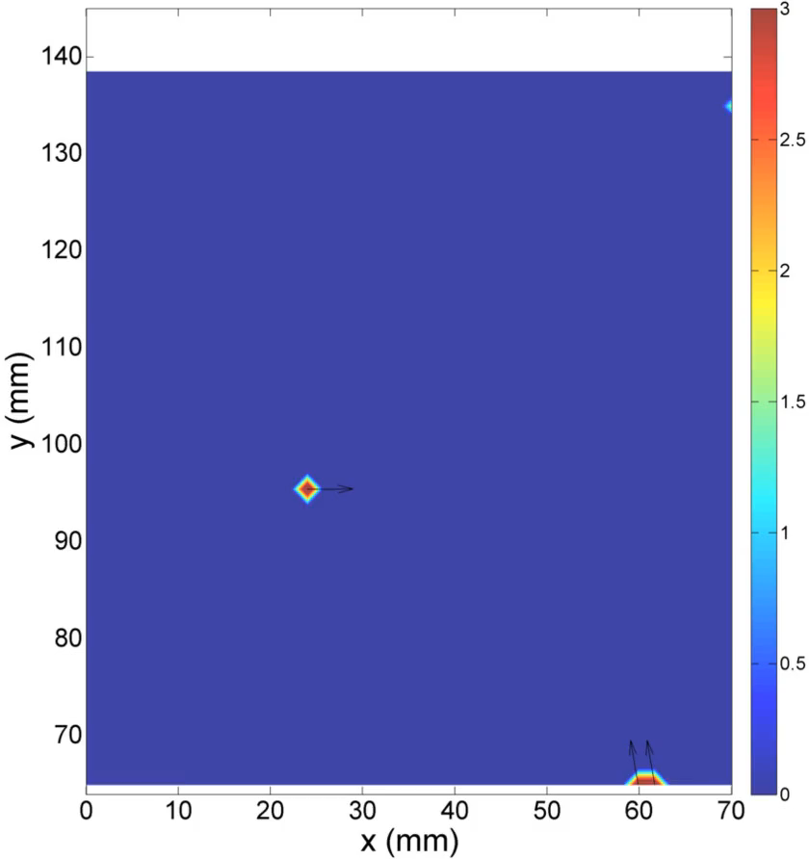
PIV, vector fields and turbulence intensity
Quantification of turbulence
Requires the mean vertical velocity at each time.
Option 1: Regression with a the best polynomial or exponential fit.
Option 2: Regression with a physical model

Slide 31


Physical Model
Quantification of turbulence
Decompression of the gas chamber from sonic to subsonic regime
Drag, buoyancy and gravitational forces
Notes:
Chamber with pressurize gas
Vertical tube
Throttling point
Trace pressure temperatue and velocity in the chambar and at thethrottling point

Slide 32


Regression of the data
Quantification of turbulence

Slide 33




Turbulence intensity
Quantification of turbulence
Behaviour of turbulence intensity for 18 ms – 300 ms
Vertical
position (mm)
Horizontal position (mm)

Slide 34
Application
Quantification of turbulence
Relating quantitative initial turbulence to the ignition energy in the Mike Apparatus
Relating the initial turbulence to flame propagation inside similar tubes

Slide 35

Flame propagation
Introduction
Pyrolysis model
Quantification of turbulence
Flame propagation
Conclusions

Slide 36

Experimental setup
Flame propagation

Slide 37






Flame propagation theory and video analysis
Flame Propagation
Burning velocity $\left(S_{u}\right)$ and the stretching of the flame $\left(K\right):$
Objective:
Extract geometric 2D structure of the flame at each frame
Estimate the 3D structure of the flame
Estimate the spatial velocity, surface and surface variation of the flame
Unstretched burning velocity $\left(S_{u}^{0}\right)$
Laminar burning velocity $\left(S_{L}^{0}\right)$

Slide 38

Analysis of videos
Flame propagation
I
N
P
U
T
Background
R G B R
G
B
Movement
R G B R
G
B
Flame elections
R G B R B
G &
B W
R
E
S
U
L
T
S
O
UT
P
U
T

Slide 39
Analysis of videos
Flame propagation

Slide 40

Limitations of the study
Flame propagation
Burning velocity vs Stretching

Slide 41


Propagation of flames from starch-methane hybrid mixtures
Flame propagation

Slide 42
Burning velocities of methane-starch mixtures
Flame propagation

Slide 43

Conclusions and perspectives
Introduction
Pyrolysis model
Quantification of turbulence
Flame propagation
Conclusions

Slide 44
Flash pyrolysis
Conclusions
A model for flash pyrolysis was built that could also be applied for slower pyrolysis.
Internal overpressure is considerably small, it will not destroy the particles.
When oxygen does not compete with pyrolysis, shrinking core models are useless.
A possible direct link was established between the MEC, the LEL of the pyrolysis gases, and the characteristics of the ignition source.

Slide 45
Turbulence quantification
Conclusions
A model was developed for understanding the characteristic times involved in the dispersion of dusts with an expanding gas.
Results for the quantification of turbulence can be used for any other dust with low terminal velocity.
These results can be used to quantitatively associate turbulence to the characteristics of the ignition.

Slide 46
Flame propagation
Conclusions
A method was developed for estimating the burning velocity of gas-dust hybrid mixtures from videos of propagating flames.
The preliminary results are promising.
It has the potential to be included in a premium class 20L sphere.

Slide 47


Les conclusions et les perspectives

Slide 48
Flash pyrolysis
Conclusions
A model for flash pyrolysis was built that could also be applied for slower pyrolysis.
Internal overpressure is considerably small, it will not destroy the particles.
When oxygen does not compete with pyrolysis, shrinking core models are useless.
A possible direct link was established between the MEC, the LEL of the pyrolysis gases, and the characteristics of the ignition source.

Slide 49
Turbulence quantification
Conclusions
A model was developed for understanding the characteristic times involved in the dispersion of dusts with an expanding gas.
Results for the quantification of turbulence can be used for any other dust with low terminal velocity.
These results can be used to quantitatively associate turbulence to the characteristics of the ignition.

Slide 50
Flame propagation
Conclusions
A method was developed for estimating the burning velocity of gas-dust hybrid mixtures from videos of propagating flames.
The preliminary results are promising.
It has the potential to be included in a premium class 20L sphere.

Slide 51


Slide 52



